Slide 1

Wendens Ambo Neighbourhood Plan
Analysis of Responses to our Community Survey Conducted Feb-Mar 2025
June 2025

Slide 2

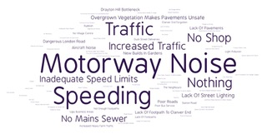

Wendens Ambo Neighbourhood Plan
Community Survey Feb-Mar 2025
We sent the survey to 255 households and received 89 responses.
This is a great response!
These word clouds are a quick summary of what you said.
The bigger the word, the more frequently it appeared in your responses.
We asked…
What do you like about Wendens Ambo?
What do you like least about Wendens Ambo?
What improvements or changes would make our village a better place to live and/or work?
You said…

Slide 3
Detailed Review of Your Responses
We read through all your comments and split them into strengths, weakenesses, opportunities and threats (’SWOT’)
We counted the number of times each comment was repeated and this analysis is shown on the next few pages
We will use a summary of this in our Neighbourhood Plan

Slide 4
What did you say?
Strengths

Slide 5
What did you say?
Weaknesses

Slide 6
What did you say?
Opportunities

Slide 7
What did you say?
Threats

